Slide 1
01
Lab Setup

Slide 2
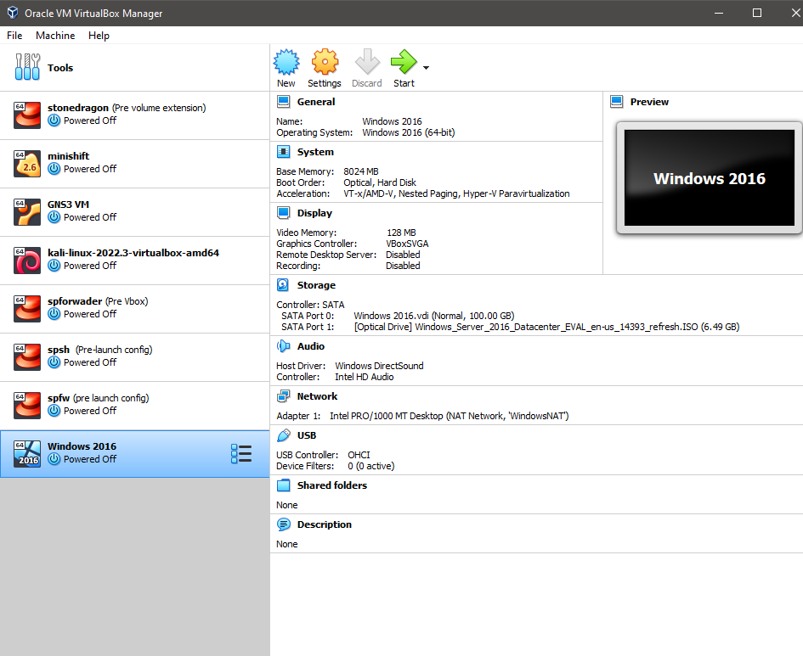
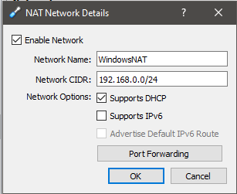
Virtual Box
Notes:
Virtual Box should already be installed on your laptop / Desktop for this lab. We are going to be installing Windows Server 2016 and adding the Active Directory Services to the server. First thing is that all of you should have downloaded the ISO image I sent you on blackboard in order to install windows 2016 server. We are going to make a new VM named Windows 2016. we have already gone over these steps so please create a VM with 100GB storage, 8GB RAM. Once that is Done we will then create a new NAT Network, This is new to us so in order to complete this we are going t o click on File -> Preferences -> New Network -> name it WindowsNAT. Next Right click to edit the new NAT Network and set the Network CIDR to 192.168.0.0/24 and support DHCP. Click ok
Now that is complete we need to assign the VM to that new NAT Network. Go to the VM click on Network change the Attached to: NAT Network then click assign to the WindowsNAT. Then click ok.

Slide 3
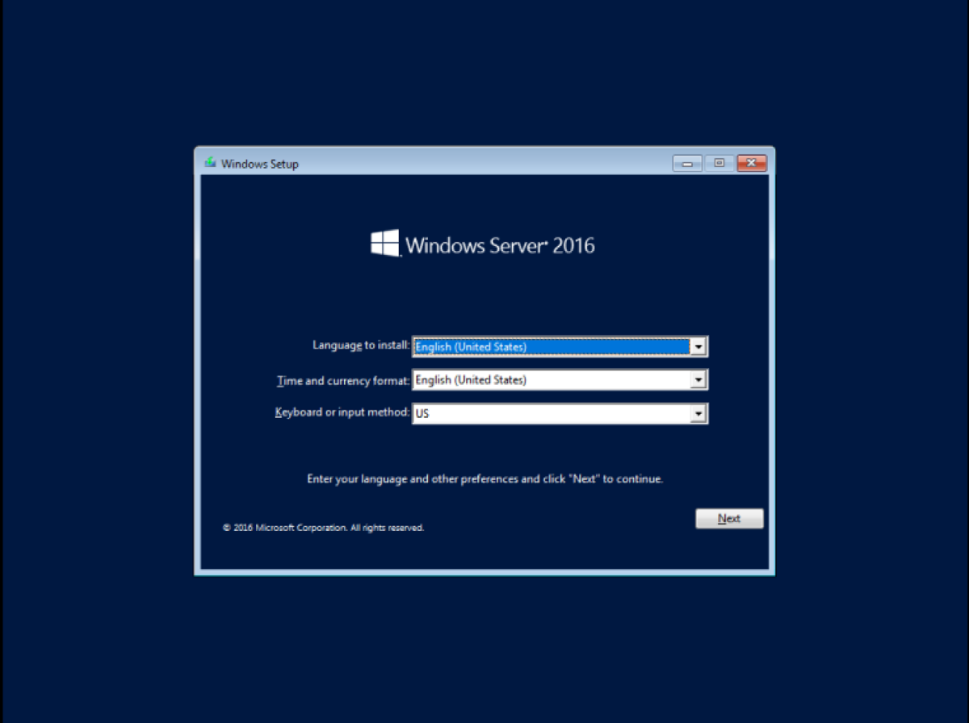
Windows 2016 Installation
Notes:
Now we are going to attach the ISO to the VM which you should already know how to do. Then we are going to boot the VM and begin the installation process of windows 2016 Server. Follow the prompts we are going to mostly click next and then when we come across what operating system we are going to install we will select Standard Evaluation Desktop Experience. Then we will come across the license and accept it. Then it will bring us to a screen to select the type of installation, We will select custom: install Windows Only (Advanced). We will then select the virtual drive associated with the VM. The installation will then begin and we will wait for this to finish. Once completed it will prompt you to make a password and then installation is complete.

Slide 4
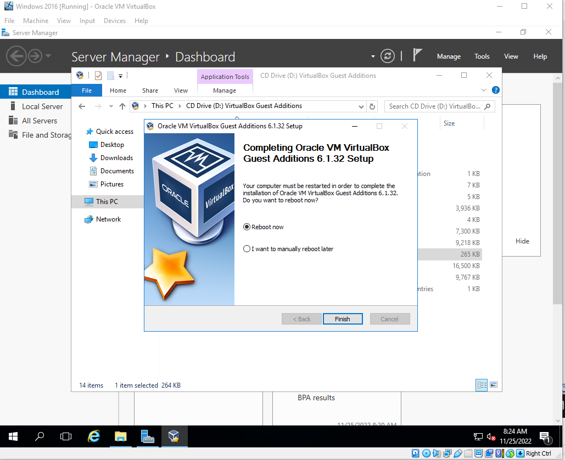
Install Windows Guest Additions
Notes:
Next we will be installing Guest additions for windows so that the VM is more friendly to use. This is a similar process to that of the linux guest additions we installed but will be much easier as we wont need any dependencies. We will now log into the server by clicking at the top of the VM window INPUT -> KEYBOARD-> Control alt delete. Once logged in then At the top of the VM window again click on devices and then insert Guest additions. This will mount the CD to the server OS. Open up file explorer this PC then click on the CD Drive. We will then initiate the Guest Additions installation by double clicking on the VBOX Windows Additions file. Once the wizard opens up you will click Next Next and then always trust and install. Then to finish reboot the VM when prompted.

Slide 5
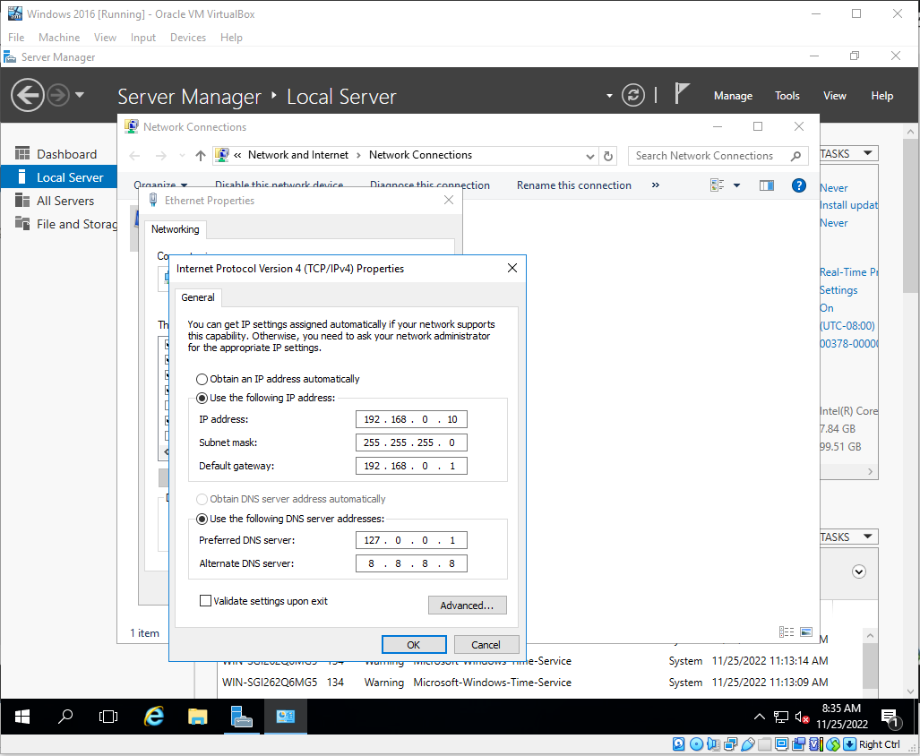
Configure Static IP Address
Notes:
Now that we have our guest additions installed we will be configuring a static ip address for our VM that will associate with the NAT Network we created. We will click on local server in server manager -> then ethernet hyperlink -> Right click on the ethernet network profile -> click properties -> disable the IPV6 protocol -> click on IPV4 -> click properties
Now we see a window where we can either leave DHCP or use the following IP Address: in which will click on that option to ungray the rest of the fields. Now we are going to give it a static IP address of 192.168.0.10 set the subnetmask to a default /24 and configure the Gateway for 192.168.0.1
Now we will move down to the DNS configuration where we will use our loopback address as the preferred DNS server. This will cause issues in the beginning because this server is not a Domain controller yet. So we will also configure the Alternate DNS server to point to Google.com / 8.8.8.8. This will allow us to reach out to google and also use it as an NTP server to get out time synced.

Slide 6
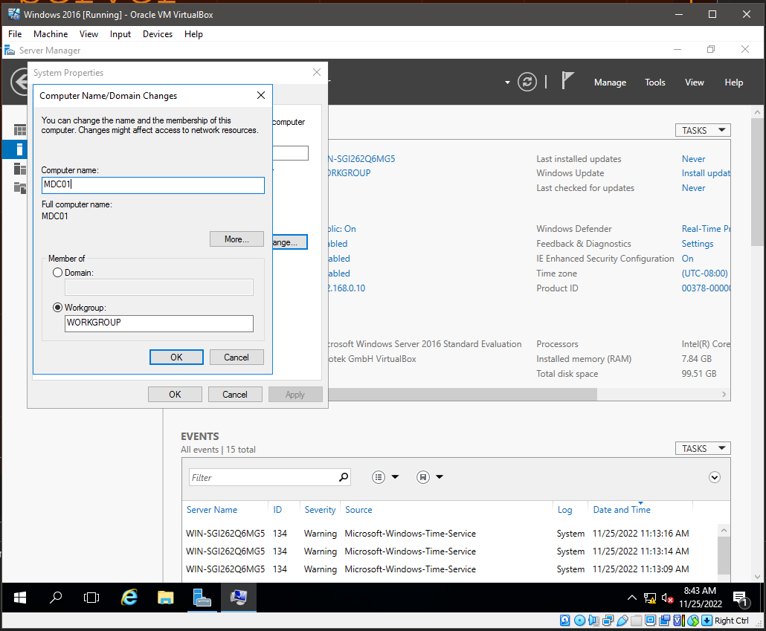
Rename the Server
Notes:
Now that we have our IP address and DNS servers configured we are going to rename this server. We will click on local server -> then computer name a new popup will show up and you then click on the change button. A new window will open and I have changed my Server to MDC01 which stands for Mercy Domain Controller 01. click ok and then close and the server will need to reboot.

Slide 7
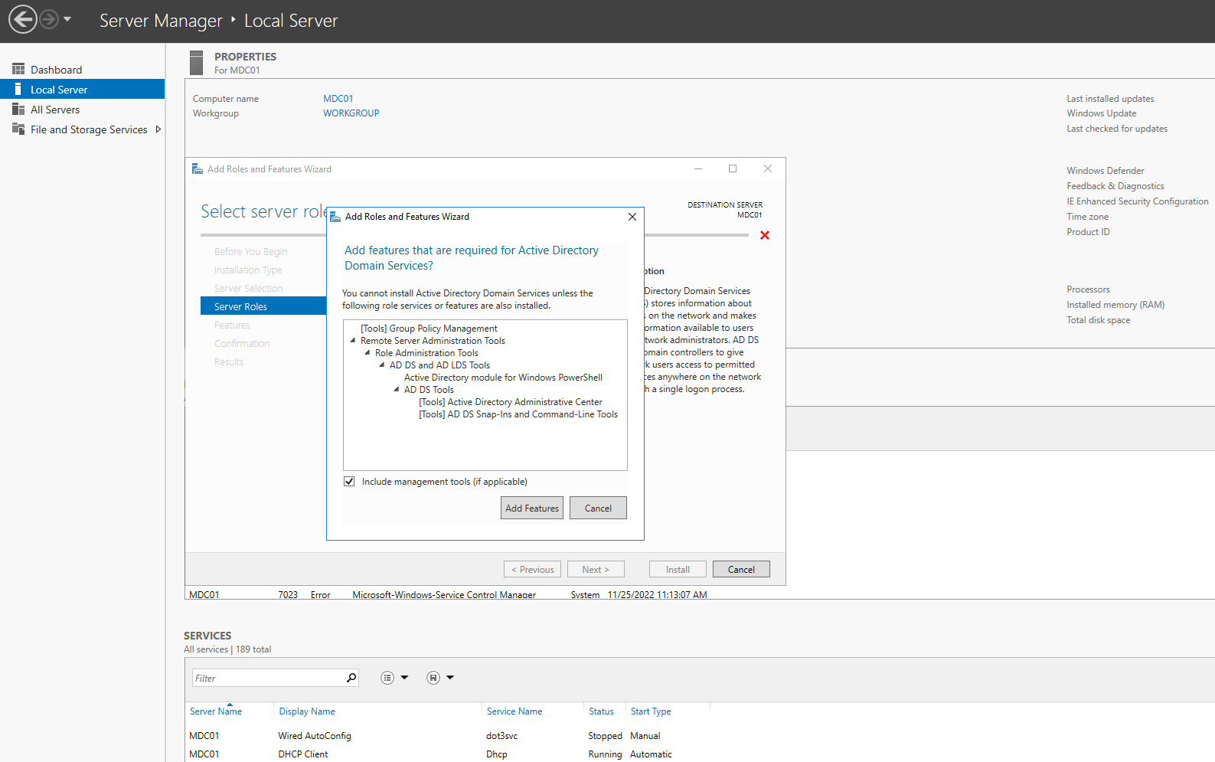
Active Directory Service Installation
Notes:
Next We are going to create our first domain controller. Any server that installs the AD directory services is a domain controller. The way we are going to install AD directory services is by going to server manager -> manage -> Add Roles and Features –> Next -> then select the Active Directory Domain Services, A new window will open requiring that you add other features in order for this service to be installed click the add features button -> no additional features required so click next -> now we come to a Active Directory Domain Services screen which under the note we can notice that AD DS requires DNS service to be installed as well. Click next and then install. Let the installation complete and there will be post AD steps to complete the domain controller installation

Slide 8
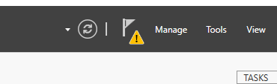
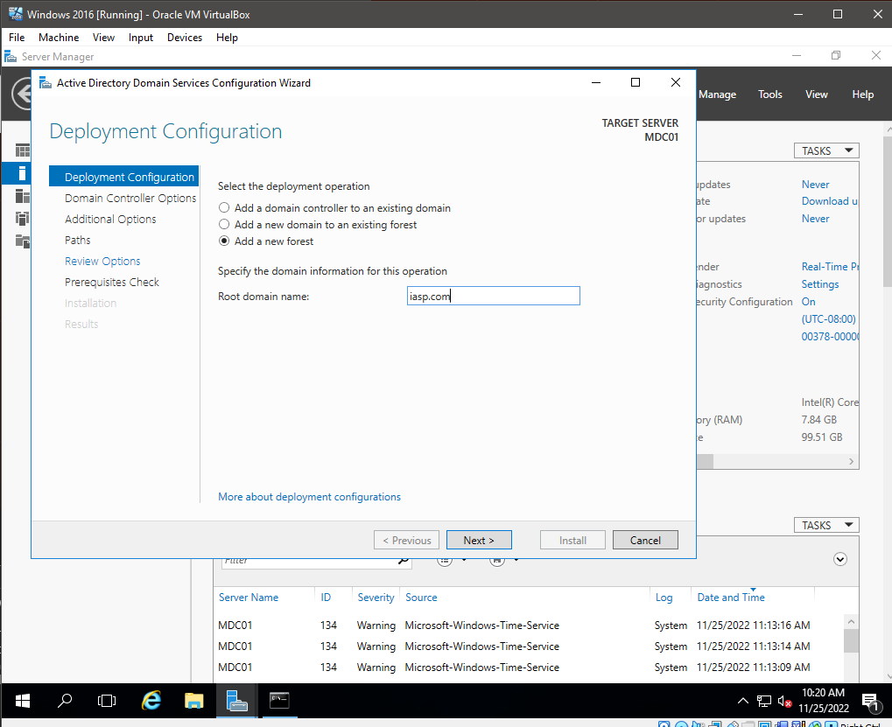
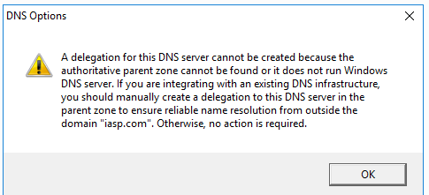
Post AD Installation
Notes:
For post AD configuration we are going to go into Server manager and we will now see a caution symbol under the Flag symbol. We will click on this and then we will click on promote this server to a domain controller. The AD DS Wizard will appear allowing us to further configure the server as a domain controller. This will give us three options:
Add a Domain Controller to an existing Domain – this option is for adding more domain controllers to an already existing domain
Add a domain Controller to an existing forest – This option is for adding a child to an existing forest in order to create a subdomain
A subdomain / child is a sub of the original domain, what do I mean by this? For example we can have our main domain called iasp.com that houses our Admins and Developers and then a subdomain called courses.iasp.com which houses our Students and Teachers. We can configure AD so that the Admins and Devs can make changes to the subdomain but the Students and teachers can not reach the parent domains resources.
Add a new forest
This option allows us to create a new domain
DNS server should be checked off
Global catalog option means that the server will list all AD objects requirement for the primary Domain controller
Read only domain controller means that this domain controller will not be able to make changes to the domain (Do not check this off)
Chose a password for restoration of AD DS. This is very important. Because this the only way for you as an IT professional can recover a domain controller that gets corrupted.
Proceeding on we come to the DNS options
We can see a warning box above about a DNS delegation, this means that people on the internet will not be able to resolve your domain like MDC01 and iasp.com which is fine because this is good for security and will not cause a collision with another domain.
The next step in the wizard is the Netbios domain name which is an abbreviation of the FQDN or Fully qualified domain name, leave this as the default
Next is the PATHS screen which will want to leave at the default settings
Next is the review option which we can review all of our options that we chose along with save a powershell script that we can use on another Domain controller in the future to replicate this server.
Next step is the perquisite checks which will let you know of any errors that it may find on the Domain controller. You will want to fix any critical errors that may come up before continuing with the installation. The warnings we see here are ok as most of these do not pertain to us.
Click install and let the installation finish
The server will reboot and when it comes up you will a new user called iasp\Administrator this will be the administrator account for the domain now.
When we log in we will now see new rols in server manager. You have just created your first domain controller congratulations!

Slide 9
02
AD

Slide 10

What is AD Users and Computers
Notes:
AD is a tooled installed by default by adding the AD directory services role to a server.
This tool is a database that contains User accounts computers printers file shares and security groups
A security group can be made up of User accounts Computers Printers File Shares and other groups
We use security groups for security reasons.
We can also use Group Policy to set the permissions of objects within AD
The purpose of AD is for Security Authentication and Centralized Security Management of Network Resources
We only want authorized users to logon to network computers and all the user accounts are stored in one place instead of each individual computer
Most common task for AD is resetting passwords and creating or deleting accounts. If we did not have AD our life would be very stressful because each computer would need to have its own user accounts reset / updated/ deleted. If you have a 1000 computers you need to do this to it would be very tedious and stressful to accomplish.
Now logging into our domain controller we can take a look at the UI of AD by going to server manager and clicking on tools then clicking on Active Directory Users and Computers
File Tab has either options or exit. The options tab can allow us to delete changes made to the AD view or the UI
Action tab is the same screen you will get when right clicking on an AD object
View Tab allows us to add or remove columns to the AD UI Most importantly from here you can enable Advanced Features, This viewing mode allows us to see a lot of hidden fields in AD
We can tailor the UI to filter certain fields throughout AD in this tab
Help can reach the tech docs at Microsoft but we will be just googling any issues we come across
Now there are multiple radio buttons below the tabs UI
We have navigation buttons and other radio buttons that will change depending on the object you have selected
If we look below these buttons on the left hand side of the UI we have our navigation pane which we see our domain name.
If we right click on the domain we get options like
Delegate Control
Find – Click on this to show the search feature
Change Domain – we would click on this if we had a subdomain
Change Domain Controller
Raise domain functional level – This option would allow us to raise a functional level of an older version of Windows Server. Say we had a Windows 2012 DC and a Windows 2016 DC servicing the same domain. Windows 2012 DC would not be able to use the upgraded features that Windows 2016 has, but if we upgraded Windows 2012 to 2016 then we could click this option to raise the functional level and enable the new windows features for AD.
Operations masters – Allows us to determine which masters roles are assigned to a DC server like the Schema master domain name naming master, relative Identified or RID master, Primary Domain Controller master, and the infrastructure master, If you have multiple domain controllers on a network we can choose which domain controller is assigned which master. This is important because say you have multiple DCs that can make changes to AD there might be conflicting updates that get pushed which will cause AD issues. To prevent this we can segregate what each domain controller can do against AD.
New – this option allows us to create new objects
All Tasks
Properties
Help

Slide 11
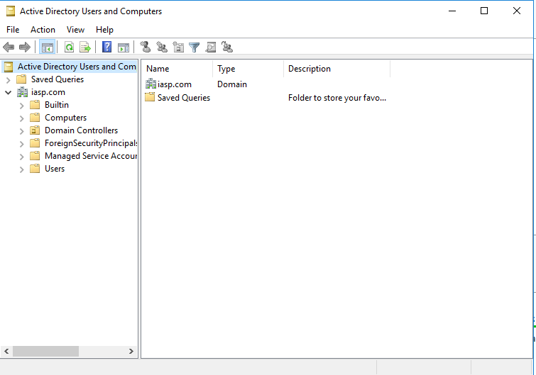
Organizational Units and Containers
Notes:
Show the server***
Now in our AD window if we click on our domain the forest expands. We see that we have different types of objects. We have a bulitindomain, container and Organization Unit. The Containers are structural objects that are included by default to the system. The difference between a container and an OU is that you cannot apply Group Policy objects to a container.
The Computers container is used by AD as default to place newly joined computers. When you join a new computer to the domain AD creates a new AD Account object in the computers container. This is important because we will want to move this object out of the container and place it into an OU so that we can apply group policy objects to the computer, like security settings, custom wallpaper, default application installations, etc.
The foreign Security Principals is a container that houses proxy objects from a trusted domain, We currently don’t have a trusted domain so no proxy objects will appear.
The managed service accounts container houses service accounts that are used by applications. This will house like the LDAP account, Splunk service account, Backup software service accounts, etc. These accounts normally will have passwords managed by a password manager due to the fact that users will never use these accounts. These accounts also do not have passwords that expire because if they did applications will break and this becomes a headache for security and admins.
The Users Container by default contains a bunch of different security groups. The container also containers the Administrator account and the Guest account which is disabled by default. It is important to note that you never want to delete any of these security groups.
If we scroll back up to the builtin domain we can see that it contains a bunch of security groups. These groups are required for the server to function. You can not delete these groups with the current permissions
Organizational Units
Ous are exactly what they sound like, They organize AD objects. We can also apply group policy objects to these Ous. The Ous house Computers, User accounts, printers, file shares, or the security groups we saw in the containers. Now since we are school we could create a Teachers OU, Finance OU, Students OU, etc. Each OU can get a specific level of permissions on a directory or file basis.
This is where security comes in to play. We would not want to have the Student accounts having the same level of permissions as the teachers and we would not want the teachers and students to have the same permissions as the finance department.
The default OU that comes builtin to AD is the Domain Controller OU. This OU cannot be deleted and will house all the Domain Controllers for this domain. There are certain policies that are attached to this OU that are required for domain controllers to operate.
***CREATE AN OU****
OU Creation Exercise
***DELETE OU***
No permissions or protected OU
Remove the protection
View
Advanced Features
Right click properties
Obejct
Uncheck protect object
Turn off advanced features

Slide 12
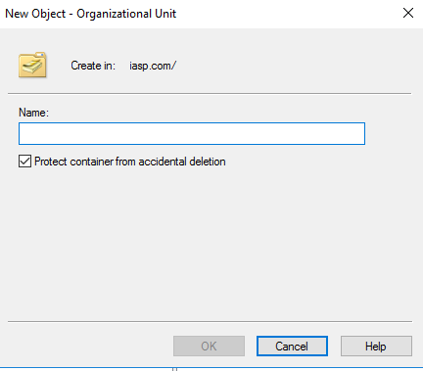
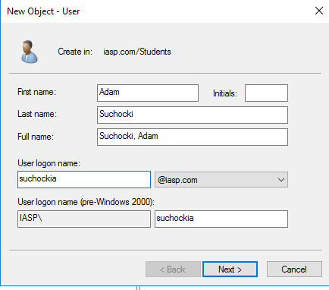
Creating accounts in AD
Notes:
Now we are going to create our first user account. Before we create the account though I want to create an OU Structure to house our account in.
We are going to create an OU called IASP
Then we are going to create a new OU under IASP called Domain Users
Another One Called Domain Computers
Now we are going to go under Domain Users
Create an OU called Teachers, Students, Finance
Once created we are going to go under the Students OU to create our first Student account
Then create an account called student0
Now when we are in the Account creation window we can see that we have multiple fields that we need to fill out. There are few ways some Admins layout their Username formats and organize their users in general but in my experience I have always typed out the first name last name changed the full name so that the last name is first and then done last name first initial. I have seen some instances where the user format is first name . Last name but it is all up to your preference as an Admin. We also can notice that there is a section for Windows 2000 which gets pre filled in as we type our user logon name. This space has a character limit due to pre windows 2000 computers having issues parsing lengthy user names.
Once we click next we will need to create a password for the account. We can also see that we can check off certain boxes.
User must change password at next logon – This one is important because if we leave this checked it will force the user to change their password the next time they logon. If they are sitting right at your desk and are just typing their password make sure to uncheck this box so they don’t have to change it again. This would be useful for say someone is locked out that is not at your facility or not at your desk and you have set them up with a temporary password.
User cannot change password – This is used sometimes for Service accounts when admins are not using MSA to managed their service accounts
Password never expires – This is not a good check box to check off because it is not good security practice. This would be once again used for a service account.
Account is disabled – This check box disables the account and you may want to check this off you it is a new hire and the account will become active once their first day begins.
Now we can click next and the account will be created
***Show that this account cannot log into a Domain Controller****
Only a joined workstation

Slide 13
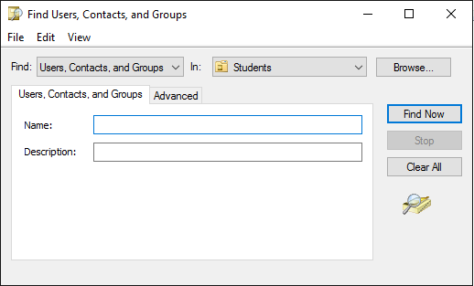
Searching for Objects in AD
Notes:
We are going to take a look at the Find function for AD because as an AD Admin you will be using this a decent amount.
If we look at the find window we see multiple fields we can tailor to get exact search results.
We the first drop down as Users, Contacts, and Groups. If we open this up we can search for specifically just computers, just printers, shared folders, OU, Custom search or common queries.
If we move to the next drop down you can see that we can search a few different areas within in AD we can search in a particular OU, the Entire Directory, or just our domain. Searching the entire directory can result in an overwhelming outcome if the enviornemnt you are working in has a large user base.
When we are say searching for a single user we want to use first and last name because if we just put say Thomas we can expect to have like 200 toms working in a company.
Now once we find our user that we wanted to find we can do multiple actions against the account, Like reset the password, delete it , disable the account, move Ous, but what if we wanted to know where the account actually resided? The normal view right now does not show us this information.
We will need to close out the find window go to view and enable Advanced Features
Go back to the search and find the user again
Right click and go to properties
If we click on the object tab we can now see the exact full path of where the user account is located
Also note that when finding an account or computer we can utilize wild cards or regex to search for AD Objects

Slide 14
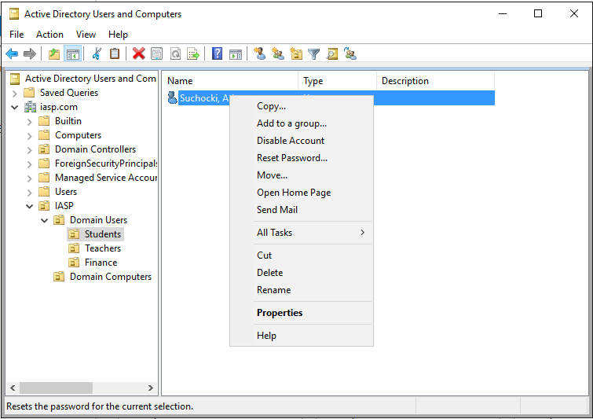
Resetting User Passwords
Notes:
Now that we have our OU structure and Account created we want to next know how to reset a user password.
This is important to know and is very easy to do.
A best practice when you get a request for a password reset is to first ask for the first and last name, Once we have this we will go to our find function and search for their account. Once the account has been located we will right click on the account and go to the properties. We will then verify their username to ensure that we are indeed in the correct account. Many times there can be multiple accounts with different variations like suchockia, suchockia1 etc. Changing the wrong accounts password is a big no no so we always want to double check out information. Once we have verified that this is indeed the account we can right click on the account and click reset password. A new window will popup with a new password field. Fill this out with their temporary password and make sure the box is checked that they will need to change their password on their next login. The last field is if their account is locked out, we can unlock the account here as well because most of the time we will have a policy in place that will lock the account after three password failures. The status portion of the lock out will let us know if the account is actually locked out or not.
Now there will be some instances where the user may remember their password but locked their account out. If we got to reset password it will force us to reset the password along with unlocking the account. To avoid resetting the password we will have to right click on the account and go to properties click on the account tab and select unlock account. There will be a message stating that the account is locked out.

Slide 15
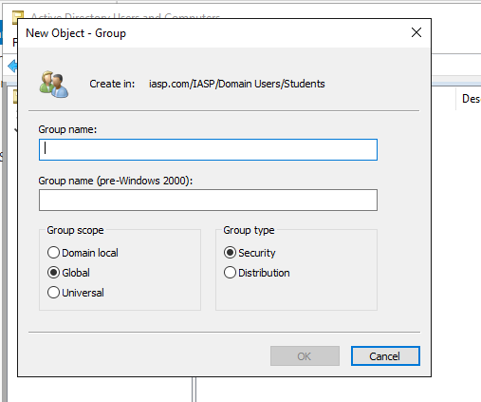
Groups and Memberships
Notes:
Now that we understand Ous, Account creation, and Resetting passwords we are going to look at groups and Memberships. In our AD environment we will be creating a new security group. If we right click under the Domain Users OU and click on new then group the group creation window pops up.
It will make us give the group a name which we will call Students,
Under group Scope if we were to select Domain Local the group would only be able to authenticate to this domain. If we had a trust between two domains the account would be accessible to the trusted domain. The global scope is the same as the domain local but allows the account to be accessed by the trusted domain, The Universal scope is the same as the Global but the account will be accessible to other trusted forests as well.
For the group type we have two to choose from the security group type and the distribution. This two types are completely different. The security group is often used to specify permissions with your AD like accessing files servers printers file shares and whatever else. The Distribution group type is solely used as an email distribution list. If we had an exchange server set up we could add all our students to this group and when we send out a student email to the student group all the students that are members of that group will receive the email.
*Go over the group properties and add the user to the group*
The member tab lists out all the users who are part of this group. We can add users to the group by clicking on add.
The Members of tab is similar but acts differently. We would use this to Add this group to another group that already exists with a specific set of permissions. So say we had a Teachers group and Students group we could add the teachers to the students group so that the teachers could see the same thing as the students but will also contain their higher level privileges as well. Another example would be adding a group to the Administrators group to allow them Admin access to the domain.
The importance of security groups is that they go hand in hand with Group Policy we can apply policy objects directly to security groups in order to maybe give students a specific background or give them access to specific sites or computers etc.

Slide 16
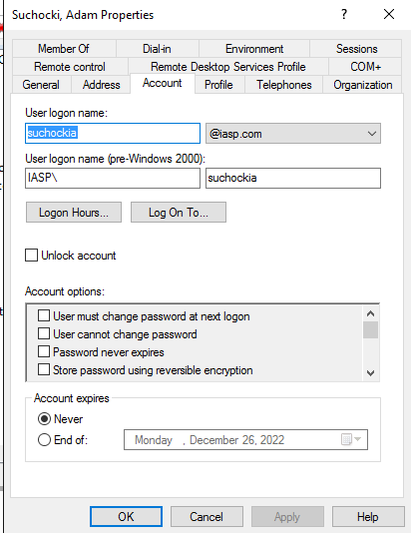
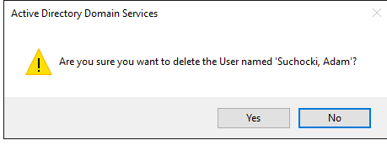
Disabling and Deleting Users
Notes:
Now deleting and disabling account is another AD Task that is important to just know how to do. Most companies will have policies on how to handle Account Deletions or disable. When we would need to delete a user? Well if an employee quits or is terminated we will need to disable the account then delete it. What many companies will do is create another OU specifically for Disabled Accounts. We do this so that when someone leaves we can move their account to this OU and ensure that it is disabled. Normally we do not delete accounts right away but disable the account for X amount of days and then delete the account. We do this because they may come back or to ensure that no applications are tied to their account.
**Run through a disable and deletion of an account**

Slide 17
03
Group Policy

Slide 18
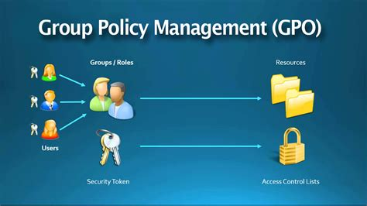
What is Group Policy
Notes:
Group Policy is a service that is installed on a windows Domain Controller. This service allows System IT professionals to deploy configuration changes to users and computers. We can make this change 1 time and it can configure 1000s of computers. We can deploy security policies across our domain quickly and efficiently. We can restrict users to log on to certain computers, allow certain users to access certain files, and deploy software across our domain. Now it is important to note that In order to understand group policy it is important to have understood the structure of Active Directory Users and computers. The way Group Policy functions is that we assign GPOs to the structure of Active Directory users and Computers that we created.
When we apply a GPO to an OU in AD the group policy affects both computer and user objects. These policies are also recursive in the fact that the parent policy will hit all Child objects
If we go to server manager and click on tools we can see an option group policy management. This will open the group policy management console. Now we see our forest called IASP.com if we expand that we now get default folders. The domain, sites, group policy modeling, and group policy results folders. The domain folder will contain all the domains that are the child of IASP.com. The Sites folder will contain all of your sites that you may have configured through active directory sites and services, This will be used when you have servers that are physically located in different locations. Group Policy modeling and group policy results are both tools that can be sued to troubleshoot any group policy issue that may arise.
Now if we expand the domains folder we can see the default domain controllers OU from AD and the IASP OU we created. If we expand the IASP.com domain we can see the other Ous we created as well.
Now backing up a bit we can see there is a default policy called Default Domain policy. If we click on this link we get a message that we have not clicked on the actual GPO but a link to the GPO. I will explain what a link is in a few slides, but this policy since it is just below the domain will configure or affect everything below or will affect the entire forest.
The Group Policy Objects folder house all the actual GPOs that were created for this forest. These are enabled and disabled policies
The WMI Filters folder allows you to add specific rules when a GPO should or should not be applied. For example you could only apply a particular GPO if the computer is using an Operating System of Windows 7 or newer.
The Starter GPOs folder is used when you want to import or export for distribution to other enviornments.

Slide 19
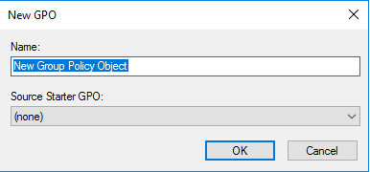
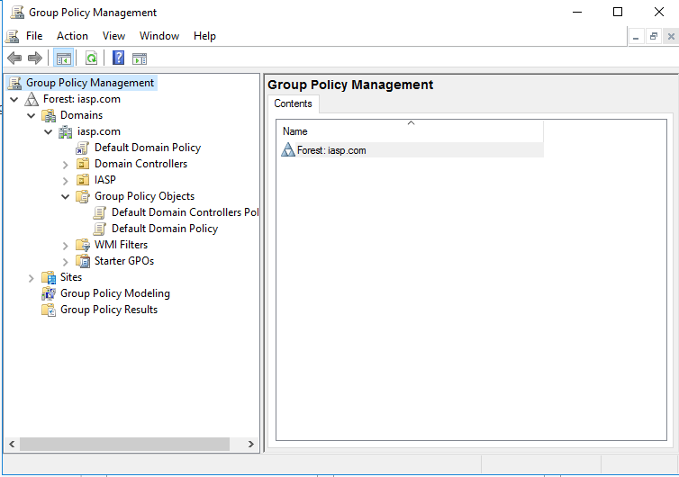
Creating and Linking GPOs
Notes:
Now GPOs contain settings and configurations that can be applied to users or computers that are stored within active directory. A domain can contain several GPOs and you will almost never see a domain that contains only one GPO. It's also important to know that one individual GPO can be linked or applied to multiple OUs simultaneously. GPOs are often used in a modular sense, meaning that the administrator might create several GPOs or just one GPO and apply them to multiple OUs as needed. For example, you could create a GPO that installs Adobe Flash Player and you might apply this to all of the OUs that contain computers, which would need Adobe Flash Player. Or you could create a GPO that prevents users from launching an explorer, and you would link that to all of the OUs that contain user accounts where you wouldn't want them to be able to launch an ad explorer.
Creating a GPU is very similar to creating a user account within Active Directory. If we go to the folder group policy objects we can right click and select NEW. This will open a new window where we can Type the name of our Object and specify a source Starter GPO. We don’t have any source starter GPOs yet so this will remain blank. Once we create this object we can now link it to a specific OU If we right click on the IASP Folder and select Link Existing GPO a new window will popup where we can select which GPO we want to link to this Folder. Once we link the Object to the Folder if we right click on the Link under the folder and select delete we can see that we are only deleting the link and not the GPO it self.
If we right click on the Domain and select Create a GPO in the Domain and link it here, we can have a GPO created and have it automatically linked to the appropriate folder. In my experience I have always created all my Group Policy Objects first and then assigned them once I have though about where These policies need to go. I Normally create a GPO depending on the relevance of the setting so if I am creating a policy for Users specifically Password complexity I will create an object specifically for this and it will not contain any other settings.
Now if we right click on the link that we just created we get new options to select from. We can choose Edit, Enforce, Link Enabled, Save report, New Window, Delete, Rename, Refresh, and Help. Edit will open up the object and we can begin to configure settings for Users and Computers. The enforced option will ensure that this Object takes precedent over the other. If we select Link Enabled it will unlink the GPO but wont delete it from the folder. This is good in case you need to do some testing. If we choose Save Report we can save the Object to the desktop and view the HTML version of it to see all of the settings that we have configured. The View option is only for customizing the GPO console not the Object itself. If we select rename on the link we can change the name and it will effect the Object itself
Now if we look at the Object we created we can see under scope that we can see the display links in this location, We can also see here that we have our folders that are linked to this gpo listed as well. If we look down further we can see the security filtering section where we can add and remove users, groups, and computers that get affected by this object. If we look further down we can see the WMI Filtering section which if we had any would show which Filter is attached to this Object.
Note that if we notice the Authenticated Users groups, we cannot click on properties because this refers to any account that can authenticate against the domain, Could be service accounts, computers, users, printer accounts.
Now if we go over to the Details tab we can see the Domain: The owner, when it was created, when it was modified, User version, computer version, Unique ID: GPO status and a comment section. The User version and Computer Version are important because if we have multiple Domain Controllers that are sharing the same GPO, if you make changes on one GPO it will need to replicate to the other GPO. So if I had another Domain controller for IASP.com and I had made a change to one of the GPOs, we could go to the other domain controller and check the version of that GPO to determine if the replication is working or has not finished. If we look at the GPO status we can enable the GPO or Disable it.
Now if we go to the settings tabs, This is going to show us the same information as saving the report. This will display the current settings that GPO has configured for user and computers.
Moving on to the Delegations tab this contains the users or groups that can read, modify or delete the GPO

Slide 20
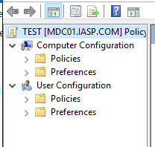
Group Policy Precedence
Local GP (least Important)
Site
Domain
Organization Unit
Sub Organization Unit
Enforced Group Policy Objects (Most Important)
Computer VS User
Computer First
User Second
Notes:
Now group policy precedence means the order in which things are applied. There is an order in which GPOs are applied down the forest. This is important because understanding how settings are applied will assist you in good policy writing. Our first layer that is applied to the computer is Local GP which is the least important, Next we have our Site Policy, Any objects applied to the site folder will be then applied to the computer and local GP will be ignored or override. Next we have our Domain policy which will get applied on top of the site objects in local settings. The Organization Unit is next and any GPO assigned to an OU will be added to the local settings as well. This also goes for Sub Ous which is last and therefor takes precedence over anything that is above it. We then have any Enforced Group Policy Objects, This occurs when we right click and want to make the GPO the most important when getting applied. Just remember the last Policy to get applied when a machine boots up or a Gpupdate occurs wins and will take precedence
Now we have to take into consideration Computers and Users. The computer configuration is applied first and the User configuration is applied second. If we remember before that the last policy that gets applied wins, If we have conflicting settings in the computer and users config, then the users config will win and override the computers setting.
Wallpaper scenario: So if we have a computer configured via local policy to show a Mercy College Background this would take. Now if someone made a GPO to a site Folder and applied a new Background like the google logo, then this would take precedence over the previous. Now if a Domain Policy was added and that policy contained the background image for amazon this image would now take precedence over the previous. Then someone adds an OU level Object that configures the background to be Redhats image now this background will take precedence over the previous. And lastly if someone added a policy to the sub ou and changed the background to Kali Linuxs website image this would win over all the others and make the background this image. But after all this if we say enforce the domain policys background GPO then since this is last applied Object to this system the Amazon image would win the background.
Blocked Inheritance is another option we can do in order to make sure that policies are getting applied correctly to the right OUs. Say we have the GPO Password Complexity and interactive logon linked to the IASP domain but linked to the finance OU we have Background GPO. If we block inheritance on the finance OU the background GPO will still apply to the finance users and computers but the password complexity and interactive logon GPOs will not apply since they are inherited by the IASP domain level.
Now if we introduce a enforce on the password complexity GPO in the IASP domain and Blocked inheritance is still enabled on the finance OU the Password Complexity GPO will still get applied to the Finance OU.
We can remember the order of GPOs by using the acronym LSDOE (local Site Domain Organization Unit and Enforce)

Slide 21
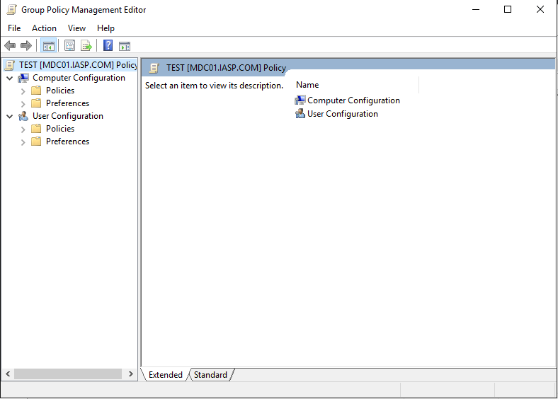
Editing a GPO
Notes:
Editing a policy is pretty simple but looking for settings can be very cumbersome. If you ever need to know where a setting might be just google it. Now we can see that we have Computer configuration and User Configuration. Note that if we apply a GPO that has Computer Configuration settings to an OU that only contains Users these settings will not get applied. This goes for vice versa as well. It is best practice to keep your computer OUs and User OUs separate. There are many differences between the User and Computer configuration settings though. Like we can see that the Name Resolution Policy is not under the User configuration and that Folder redirection under the User Config is not under Computer Config. This is because Folder redirection is only for users.
**Go through some of the settings*** Encourage they go through them to get an idea of what settings are where.

Slide 22
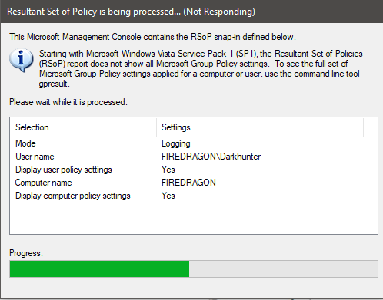
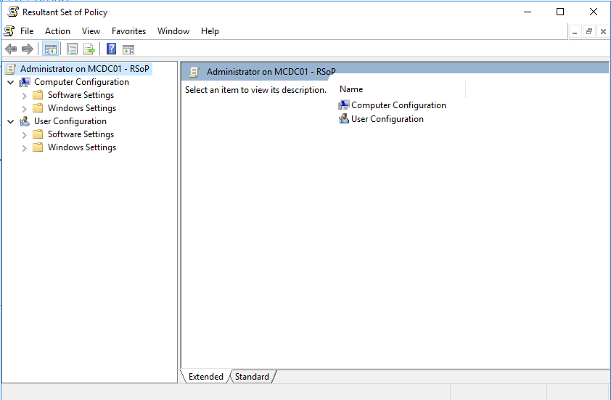
Troubleshooting with MMC RSOP
Notes:
Now that we pushed some Policies through Group Policy we need to know how to troubleshoot these policies. One way we can do this is by using Resultant set of Policy or RSOP. We can find RSOP by typing RSOP.msc in the search bar of windows. Once the program has been found and you click on it, RSOP will begin to analyze the current policies of the system. When complete it will open up a window that resembles Group Policy Managemet. This window will contain all the Policies that are being pushed to the system.
We can find rsop on any version of windows by running the same program. Rsop will let us know whether there is an error from group policy that is getting pushed to the system. It will also tell us which policy is the issue. We can see which policies are defined and which ones are not. We will also be informed of the source GPO that the setting is getting pushed from to further troubleshoot.
If we click on a setting we can look at the details like the template security policy setting, Precedence, and explain to see what the setting is actually doing.

Slide 23
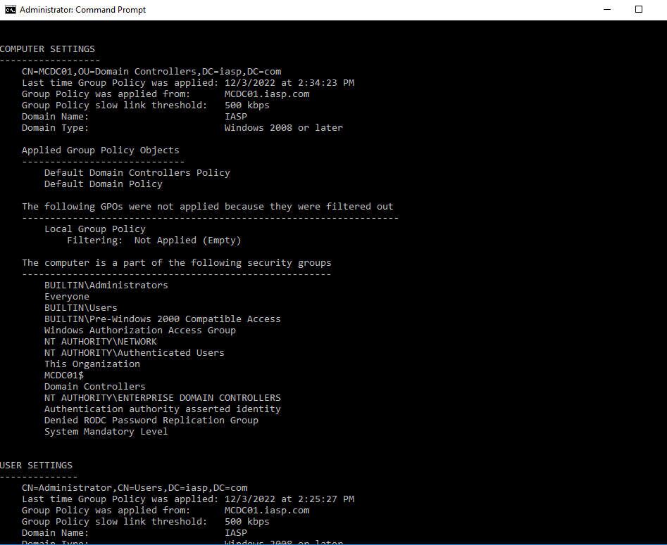
Troubleshooting with CMD
Notes:
Another troubleshooting tool is the command prompt, if we go to our windows icon and search for CMD we can right click and open an administrative command prompt. Once this is open we can run a command GPRESULT /R. This will generate a report that will tell us what policies are being pushed to the user and the computer. We can break this down a little further is we look at the output.
We first see some version output from Microsoft then we come across the RSOP data for the user. We can see the OS configuration, Local profile which is important to know if you are using roaming desktops.
We then look further down and can see the CN, OU, and DC that the PC sits under.
We can see when the last time group policy was applied
We can also see which DC the PC received its policies
We now are looking at the Applied group policy objects, This is important because this will tell us exactly which objexts are getting applied. So once we run the command gpresult /r the output will tell us immediately what objects are getting applied and we can see if our policies are working.
Looking at the filetered output this is where we would see security settings and any User configured settings
Moving down further we can see the memberships that the PC is currently apart of. Now past this output we can see the exact same information but this time it is for User settings. If we notice that under the user settings output there are no applied group policy objects right now because by default user settings are not configured under the default domain policies.

Slide 24
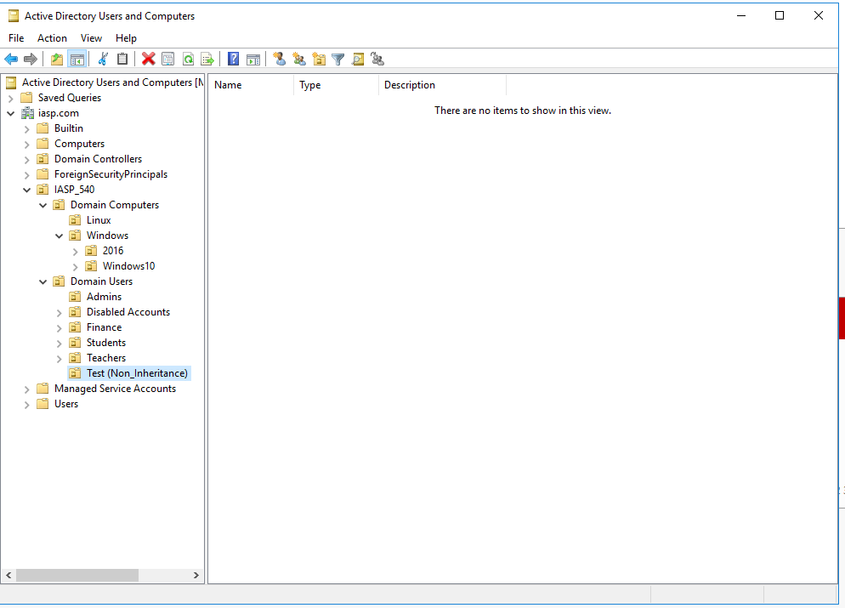
Creating Non-inheritance OUs
Notes:
Going back into our AD users and computers we are going to create a Non-Inheriting OU. We will go to tools, Active directory users and computers and expand the domain. A non-inherting OU means that the OU will not inherit any group policy objects that are not directly linked to the OU except for those Objects that are enforced.
I am going to create an OU under IASP -> domain users and call the ou Test (Non-Inheritance). Then I am going to move the administrator account under this OU. Now we have not applied any GPO yet to this OU so now we are going to go into Group policy, expand our domain and go to the test OU. We are going to just edit the default domain policy and add some user settings to this object
Policies
Admin templates
Desktop
Desktop
Disable Active Desktop
We will close out of the gpo window and open an administrative command prompt. We will then run the command gpupdate in order to immediately update group policy on the server
If we run gpresult /r we can now see that the default domain policy is being applied under the user configuration settings.
Now we can go back into group policy management and create a new object under the test OU we can call this test01
Now that we have a new object we can go and edit it. We will go under user configuration preferences windows settings folders and then right click new.
A new window will popup and we will leave the action as update call the path C:\TestFolder and then click apply and ok.
We will now run another Gpupdate but with the /force flag
Then we will type gpresult /r to confirm that both objects are being applied.
We will now turn the test OU iinto a noninherting OU, We will right click and select block inheritance. We can see that there is now an exclamation point next to the object identifying that this object is blocking inheritance.
If we go back to AD there is noway for us to know if an OU is getting its inheritance blocked so that is why I recommended we name the OU with non-inheritance.
Since we have just blocked inheritance we will need to rerun the Gpupdate and then run gpresult /r
We will now see that the only policy that is applied we will only see the test ou policy
Now if we go back to Group policy and click enforce on the default domain policy we can see that now both of the policies are applied again if we run gpupdate and gpresult /r
Undo everything we just did move administrative account back.

Slide 25
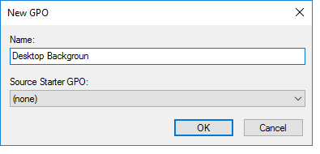
Deploy Desktop Background
Notes:
Now we are going to deploy a background to our windows 10 workstation. It is important to note that this setting is a user configuration, so we will need to assign this to our authenticated Users OU which is our Domain Users. The first thing that we will need to do is create a file share that is accessible to all authenticated users containing the background image.
First I want to add a secondary drive to our Server so I am going to shut the server down and assign a new drive with around 25 GB. We are going to use this for our shares. Once we add the Storage to the VM we will need to login and go to computer management and disk management then initialize the disk for Master boot record. Then we will right click on the unallocated disk space and create a new simple volume. Go through the wizard and the drive will now appear as the data drive on Drive letter E.
So we will go under our windows file explorer click on our C drive and create a new folder called share. We will then right click on the folder and go to properties. Next click on the Sharing tab and go to advanced sharing. Now give the share a name in this case I called it share. I also changed the permissions and added the authenticated users group in order to allow access to the domain users with read permissions and removed the everyone group. Now grab any picture off the internet in the jpg format and place the file in this share.
We will need to test this share with our windows 10 workstation by going to the path of the share through file explorer. We will open up windows file explorer and in the URL area will type in \\192.168.0.10\share to access the share. Make sure that you login with the authenticated user we created.
Once the share has been confirmed we are going to go into group policy management and create the desktop object and configure the setting. Remember we need to link the object to the users OU and configure the User setting for the desktop background. Which means if we tried to configure it under the computer OU it would not apply.
We are going to create the Object under our domain and call is Desktop Background. It is good practice to create an object for every setting that you want to configure. So if we were configuring passwords we would create a password object and only place password related settings here. If we did all our settings under one Object and there was an issue with our workstation due to group policy it would be very difficult to troubleshoot and narrow down what setting is wrong.
Now we will right click on our desktop background object and click edit then go to user configuration policies Administrative templates desktop desktop and choose the desktop wallpaper settings and click edit.
We will enable the setting and type out the name of the wallpaper name which is actually the full path to our jpeg. We will leave the style as center. We want to use the UNC path not the local path. My path is \\MCDC01\Share\Share\file.jpg
To make life easy we are going to go to the location of the file on our workstation shift + right click and copy as path. This will copy the full path plus give us the file name and will paste it into our GPO.
We complete this setting and close out the window. Then we will go to our workstation run our gpupdate give it a few minutes then run gpresult /r to ensure that the policy is being applied then log out of the workstation and log back in to see our background.

Slide 26
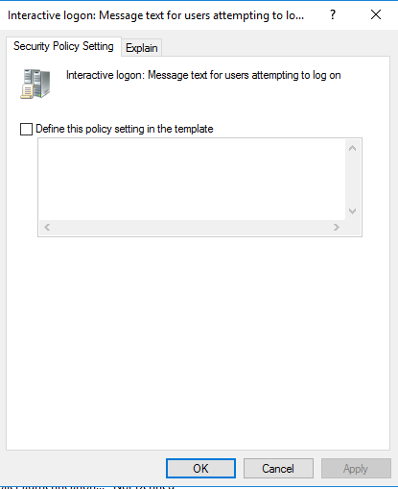
Setting Up Logon Banner
Notes:
This time we are going to configure an interactive logon banner. This setting is used for when companies want to show some sort of warning before logging into a system most commonly this is seen in government work saying something like warning you are accessing a government system only authorized users are allowed.
This setting is a computer setting so we will create a new object and call it interactive logon. Now we will right click on the object and click edit then go to Windows setting Security Settings local policies security options and then find the setting interactive logon: Message title for users attempting to logon. Here we will give the message a title and type in Warning Mercy College Asset
Then we will find the settings interactive logon: message text for users attempting to logon and write “This is a mercy college asset only authorized users are allowed to attempt a logon to this system. Unauthorized access will result in an investigation”
Then we will click apply and ok.
Go to our workstation then gpupdate and logoff the system to see the interactive logon screen

Slide 27
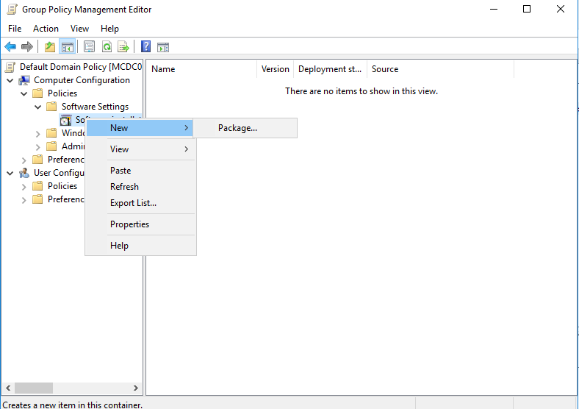
Deploying Software with GP
Notes:
Now that you know how to set up an interactive logon banner we are going to now use group policy to deploy a piece of software. In particular we will use 7 zip. We will need to download the 7zip.msi file and store it on our Server in a file share like the background. We will create a new folder under our share folder called software. Once we place the application in this folder we will go to group policy and create a new software deployment GPO. The Software deployment setting can be either a per user basis or computer basis.
We are going to link this GPO to the Domain computers OU. Note a good practice to deploy software is to create a GPO per software deployment in order to easily troubleshoot or remove the software from the computers.
If we deploy under the computer settings the computers will require a reboot in order for the software to take affect. If we deploy under the user configuration everytime the user logs in the software will get installed and this will slow down the login time for the user because their environment will need to be configured during the login phase. We will deploy the software through the computer configuration because we want 7 zip on every computer regardless of the user.
So in our newly created GPO we will right click on select edit under computer configuration we will expand policies then software settings then right click on software installation and select new package. Now here is where we will select the 7zip.msi file that will get deployed to all our computers. In order to do this we will have to go to \\MCDC01\share\software\7zip.msi and then click open. This path cannot be local it has to be to the share because the computer must be able to access the file.
We will then leave the deployment method to assigned. Published is grayed out because we are deploying to the computer not the user this would allow the user to choose whether or not to install the package. If we choose advanced it would allow us to configure for published and make changes to the package but we are not going to do that either.
We will now close out of the GPO and run a gpupdate on the domain controller. When we run our gpupdate we can see that we get a warning that the change must be processed before system start up or logon. We will then click Y to initiate the restart. We can also do shutdown –r –t 0 to force an immediate restart.
Now once the server comes back we can see that 7zip has installed on the computer.

Slide 28
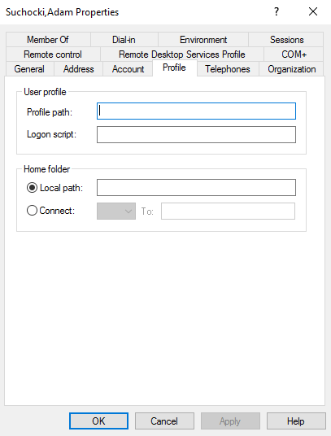
Configuring Roaming Profiles
Notes:
Now I am going to introduce how to configure roaming profiles for your users to ensure that any computer that they logon into will have their preferences set. Seeing how we already know how to create a share using file explorer this time around we will use Server manager to create the file share.
We will go to server manager and click on File and storage services and select shares now we will right click and select new share choose SMB share – Quick click next and we will select our E drive, but please note in the real world we will want to have more than just 25 GB of storage because users will be savings their pictures documents downloads etc to this drive now. In our instance with one user this is acceptable. Next we are going to name our Share Profiles$ we want the $ because this will hide the share from the shares when just searching for the normal share. They will still have access just wont be able to see it. Next we are going to enable Access-Based enumeration so that user can only see files and folders that they have access to. We will also check off the encrypt data access to encrypt our remote file access
Next we have our permissions and by default you see that there are user groups. Microsoft recommends to remove these groups. So in order to do that we have to first disable inheritance to release control of the permissions. Once we click on this we can see that a window pops up asking to conver or remove the inherited permissions we select convert inherited permissions into explicit permissions on this object. This will take the inherited permissions and sets up a new set of permissions just for this share. We will now remove both user objects.
Next we are going to create a new user group so we will have to go into active directory. Under the domain Users OU we will create a group called Roaming Profiles. It will be a global and security group. We will then add the user we created to this group.
Now that we have our group we are going to go back to our share wizard and add permissions to this group for the share. Click on Add and select Prinicipal, Search for Roaming Profiles, Unselect all the permissions on the first window then select advanced permissions. We will select List folder / read data, Create folders / append data. Next under applies to drop down we must select applies only to this folder. Click ok then apply.
We will then go into the administrators permissions and click edit. We will change the applies to, to match the previous group so we will select This folder only as well. Then click ok.
Now we will click Apply and ok then next and then create. Now we have officially create the file share using server manager.
Now that the share is set up we will have to go back to Active Directory in order to edit the Users Profile path. So we are going to select the user that we created right click and go to properties. Choose the Profile tab and we will have to inset the UNC into the Profile Path location. So it will look like \\MCDC01\Profiles$\ and then we will add %username% so that it creates a folder under the profiles share with the users username. Now we will click ok.
Now to test this we will login to our workstation. We will then search for control panel and go to system then select advanced system settings and under the advanced tab we can see user profiles select settings and then we can now see that our current user has a roaming profile

Slide 29
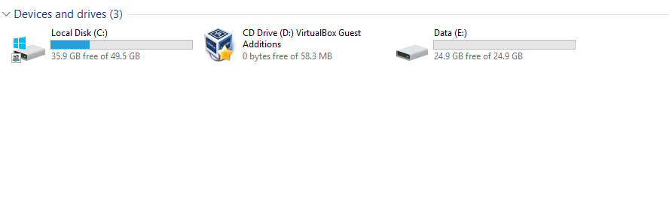
Automatically Map Network Shares
Notes:
We are going to now create network shares that will have permissions for a group A and Group B in which Group A will not be able to access Groups Bs share and vice versa. These shares are also going to be mapped to the users accounts automatically. So to begin we will need to access Server manager and open AD. We already have our Students Group under our Students OU so under our Teachers OU we will create a new User called Professor and a new security Group called Teachers.
Now we are going to make sure that our students account is in our students security group along with our teachers account in our teachers security group.
Next we are going to create our two shares using server manager and go to file and storage services then shares. We will then right click and select new share and use the SMB Share – Quick Then select the E driver for our storage drive, Then Click next, Share name will be students and then we will move on to Other Settings leave this tab default and move on to permissions and click on customize permissions. Disable inheritance and select convert, We will remove the default user account. Now we will add the Students security group to the share, We will leave the default permissions for the group and also add the write permission. We will then click ok
We are going to repeat the above steps for the teachers Share and security group.
We will need to test that the file shares are working properly so we are going to log in to our workstation and first login as our student and try to access both shares. Then we will do the same for the teachers account and attempt to access both shares. We can see that one of the shares gives us a permission denied and one allows us to view the contents in the share.
Now that we know that the permissions are working properly we are going to move on to mapping the network shares automatically. We will have to go into Ad and create a new object under the teachers OU and Students OU. So under the Students OU we will right click select new and then select shared folder. A new window will open and we will name the shared folder student and then copy and paste the UNC path from file explorer Click ok and then move on to the next share for teachers
We will repeat the steps previously for the teachers share.
Now that our shared objects are in AD we now have to open up group policy. We will need to create a GPO for Students and one for teachers explicitly stating which security group gets which share. Under the students OU I am going to create a GPO called Students Mapped Drive and click ok. Then Right click and edit the Object. We will then expand User config preferences, then windows settings, then Drive Maps. Then click ok. Then we are going to remove the authenticated users group and add in the students security group.
We will repeat this process for the teachers GPO.
Last thing we will need to do for each GPO is give the authenticated users group read permissions under the delegation tab. So for each Object go under the delegation tab add authenticated users and give them read permissions. Please note this is different because what this is allowing is the authenticated user to read the Group Policy Object, not the share itself.
Now that we have completed all these tasks we can test out the shares using our teachers and student accounts after we perform a gpupdate on the workstation.

Slide 30
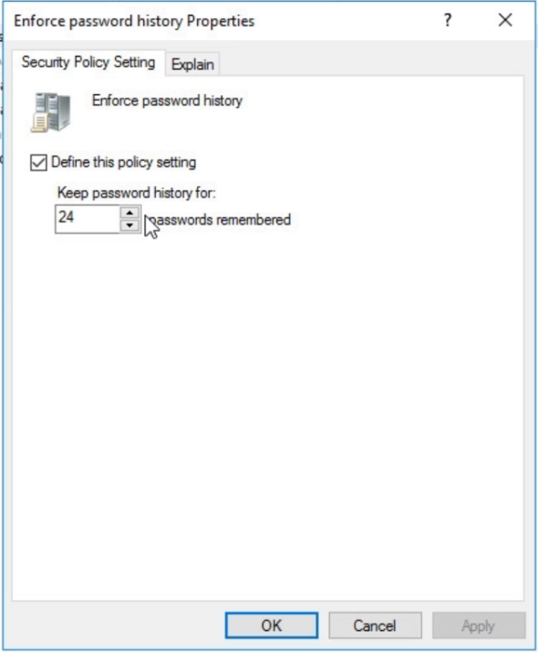
Domain Password and Account Lockouts
Notes:
Now we are going to configure our domain passwords and account lockout rules. This will be important to know so that when you are in an enterprise level environment you can configure password complexities account lockouts etc.
So to get started we are going to access the server manager and open up group policy management. First we need to take note that under the default domain policy the account and password settings are already configured so we can just edit our default domain policy and make the changes here for our passwords and accounts.
We will go uneder our computer config, windows setting, security settings, account policies, password policy, The first setting we come across is the enforce password history properties setting. This setting enforces the memory of the users password history. We want to leave this at 24 and what this will do also is that when a user resets their password if they try to use a password they have used in the past it will not accept it.
The next setting we see if the Maximum password age which I have normally seen 60 day password expiration dates. So we are going to set this to 60 days.
Next we see minimum password age which we will set to 0 in order to allow users to change their password immediately in case they realize they created a password they wont remember.
The next setting is the minimum password length which we are going to set this to 14 characters as this is still the standard.
The next setting is the password must meet complexity requirements this must be enabled.
Lastly the store passwords using reversible encryption setting must be disabled because this is basically storing passwords in clear text.
Since we finished with the password policy we can move on to the account lockout policy and we can see three settings, These settings support the idea to mitigate brute force vulnerabilities by locking the account out after three attempts.
The account lockout duration is for how long the user will be locked out of their account which we will set to 15 minutes.
Account lockout threshold we will change this to 3 attempts
The reset account lockout counter after we will set this to 15 minutes, once we completed this setting we will close out of this and run a gpupdate on our workstation.
Now we will test out the lockout for our students account on the workstation.
We can now see the account is locked out and if we go into our admin account on the DC we can see in AD that the account is locked out and that we can now manually unlock the account.

Slide 31
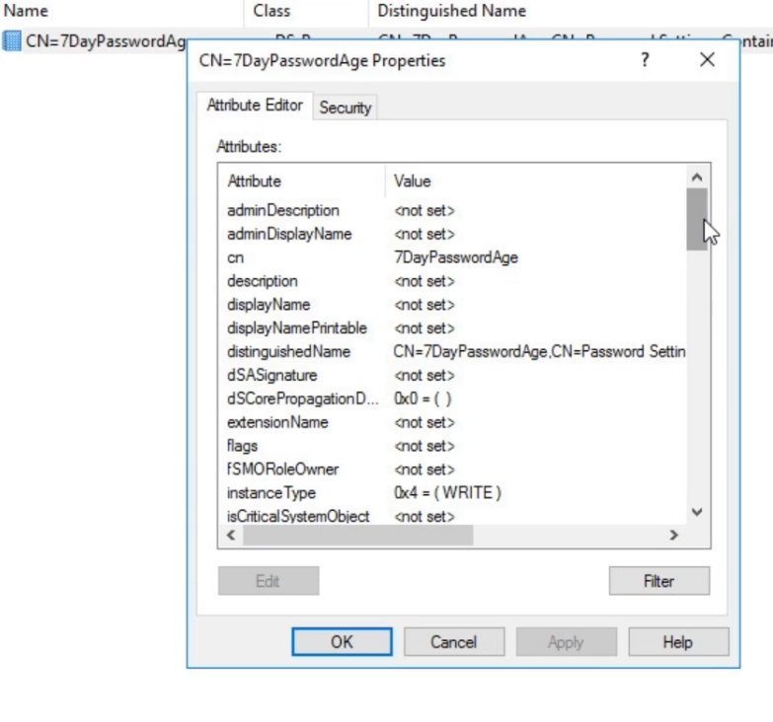
Fine Grained Password Policies
Notes:
Now that we know how to set password policies for the entire domain we are going to create a PSO or Password settings object which will allow us to set the password policies on a per user or per security group basis.
First thing we will do is that we are going to create a new security group under the finance OU called Finance PSO 7 Days age.
Now we are going to create a new user for the finance department called finance1 and add them to the finance PSO 7 days age security group.
Next we are going to server manager and then select ADSI edit, we will then click connect and leave all the defaults and click ok.
We will now expand the default naming context and then further down the tree. Expand CN=system and the CN=Password settings container. Now I am going to right click and select new object. The only setting we see is the MSDS password setting and this is the PSO setting we are looking for so we will click next and now we need to create a name for the PSO which we will call 7 day password age. Then we will set the precedence to value 1. click next then we will type in the value for reversible encryption FALSE all caps. Then we will type 24 for password history length and click next. Password complexity we will type TRUE. Min password length will be 14. The Min Password age for user accounts will be 0 but we have to right the value as such 00:00:00:00. This is the format which represents seconds , mins hours days. We will copy this format and for the max password age we will past and then change it to 07:00:00:00 days.
The lockout threshold will be 3, The observation window will be 15 mins so we will need to write the same format as before and type out the 00:00:15:00. Click next then under lcoked out duration we will do 15 mins again. Then next and then finish.
We will need to now apply this PSO to our security group we created. So right click on the PSO and go to properties we will scroll down and look for the MSDS applies to setting. We will choose this and click on edit then click on add windows account and search for our security group that we made. We then close out the window and click apply and now we can see that our PSO applies to our security group.
Now that we have our PSO set we have few ways we can verify this. We could wait the 7 days or we could change the PSO to 3 mins or we can use a powershell command to verify the expiration date. So I am going to use powershell to verify. We will open up a powershell admin prompt.
#Import-module ActiveDirectory
# Get-ADUser –f {GivenName –eq ‘Finance’} –Properties “DisplayName”, “msDS-UserPasswordExpiryTimeComputed” | Select-Object –Property “DisplayName”,@{Name=“ExpiryDate”;Expression={[datetime]::FromFileTime($_.”msDS-UserPasswordExpiryTimeComputed”)}}
Get-ADUser -filter {GivenName -like Finance} –Properties "givenName""msDS-UserPasswordExpiryTimeComputed" | Select-Object -Property "Displayname",@{Name="ExpiryDate";Expression={[datetime]::FromFileTime($_."msDS-UserPasswordExpiryTimeComputed")}}

Slide 32
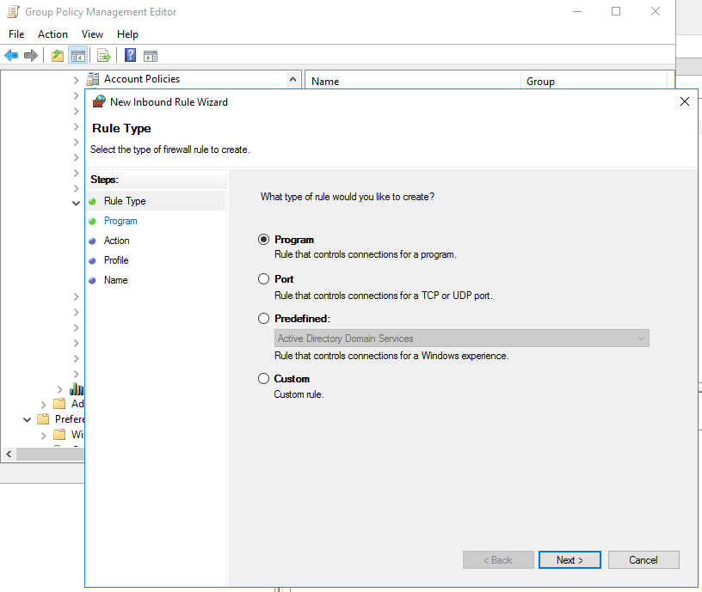
Windows Firewall
Notes:
This time we are now going to configure windows Firewall using group policy. We will open up a few ports on the workstation but then close them once we are done. So on our DC we are going to go into server manager then group policy management. We will create a new GPO under our domain computers.
We will create a GPO called Windows Firewall (9080,9443,1433,2382,2383). Once the gpo is created we will edit the object and go to computer config windows settings window Firewall with Advanced Security expand windows firewall with Advanced Security. We will click under inbound rules and right click to create a new rule. Now we are simply just going to follow the wizard and open up the ports 9080,9443,1433,2382,2383.
We will select port then click next, leave tcp and specific local ports then type in the ports we want to open, click next. Click allow connection and then allow for domain private and public. Then click next then we will give the rule a name which we can name test and all the ports numbers.
Now that we configured the firewall we can go over to our workstation and run a gpupdate to update the settings. Once the settings are updated we are going to verify the settings by using rsop. So we will search for rsop.msc on the workstation and look at the windows firewall configuration that is hitting the workstation. If we notice the firewall settings in rsop are not in the same location as Group policy so where are they? Well they are going to be under the Admin templates and then extra registry settings. We can now see that the firewall settings are indeed hitting the workstation. Once we verify that the policy is hitting we are going to unlink the gpo to not have open ports just lingering on our VM.

Slide 33
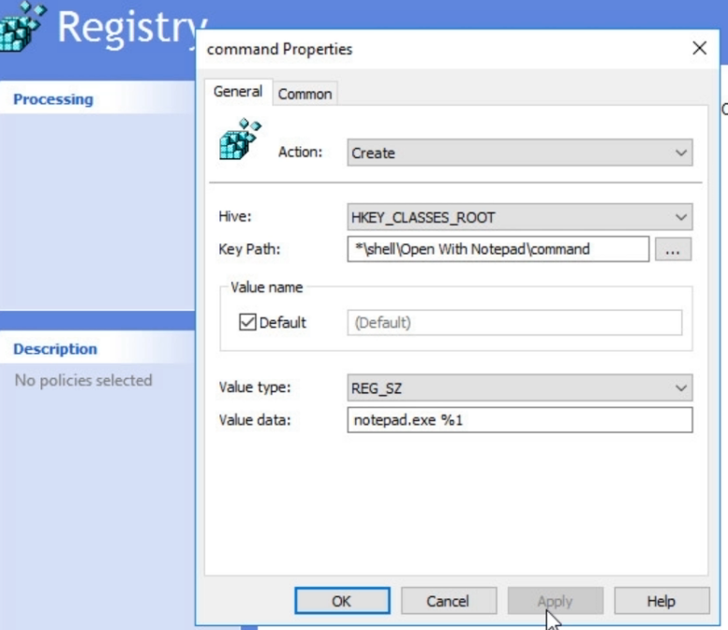
Windows Registry Settings
Notes:
I am going to now create a group policy object that will create a registry setting that will use notepad to open a file. So we will start by creating a new object and calling it registry Settings under my domain. Once created we can edit the object and we can configure this setting under either computers or users.
We will configure this setting under the computers and let it hit the entire domain. So we will go to preferences windows settings registry and right click and select new item. Please note that when updating registry settings it is very dangerous to do so if you don’t know what you are doing. A lot of the settings that you can mess with are irreversible and you would need to reformat or rebuild the PC to correct it.
Under the action drop down we will select create, then under the Hive drop down we will select HKEY_CLASSES_ROOT, We will then select a HIVE path by selecting the three dots to browse. So we will expand HKEY_CLASSES_ROOT then expand the * then select shell and click select. We will now append to this path \Open With Notepad\command.
Value Name check the box
We will leave the value type as REG_SZ, but for value data we will type in notepad.exe %1, Now click apply and ok.
We can test this now by gpupdate and then we can try and open a non text file like our jpg file.

Slide 34
04
PowerShell

Slide 35
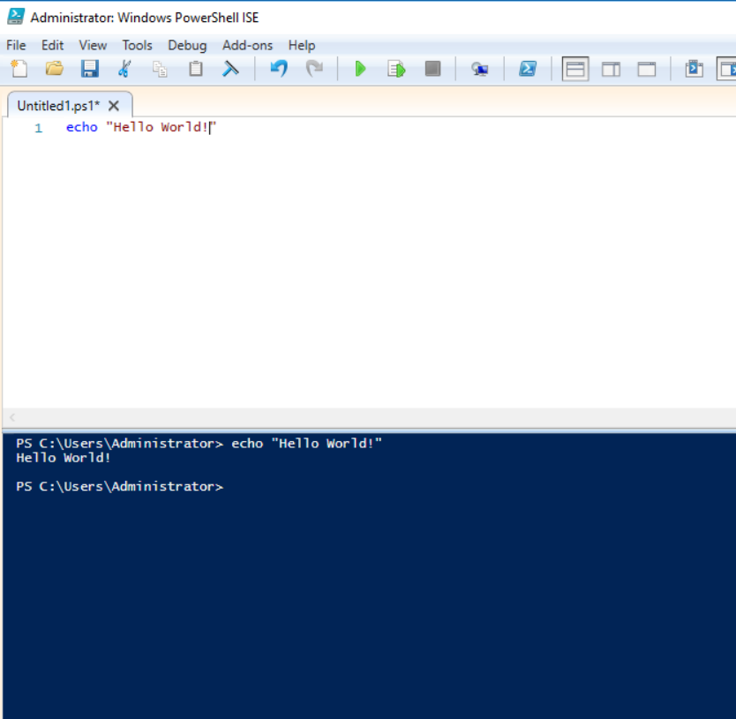
Script execution for PowerShell
Notes:
We are now going to jump into powershell. First if you run a powershell script on our Domain controller we are going to receive an error. We will need to enable script execution for powershell. In order to show this we are going to open the powershell ISE
In our windows search bar we are going to search for PowerShell and choose the ISE. This is like the code editor for PowerShell.
The first time you open the ISE it will only show the full screen of the command prompt to change this just click on the little down arrow to lower the command prompt and expose the editor.
We will now type echo “Hello World!” ad then click run. We can see in the terminal window that our command is run and the output is shown.
If we save the ps1 file to a folder we can then attempt to run the powershell script. Note that this works because script execution is not configured. In a production environment there will be STIGs or hardening performed and best practice is to disable this setting initially. Depending on how secure the environment is we can enable this on a member server and lock down the groups who can access this server. The setting we are looking for is uner the window powerShell setting Turn on Script Execution. Typically this would be configured to disabled but we can enable it by going into the default domain policy, Under Computer config, policies, Administrative templates. Windows components, windows powershell. Then configure the Turn on Script Execution to not configure / enabled.
Note this setting is also under the user configuration as well.

Slide 36
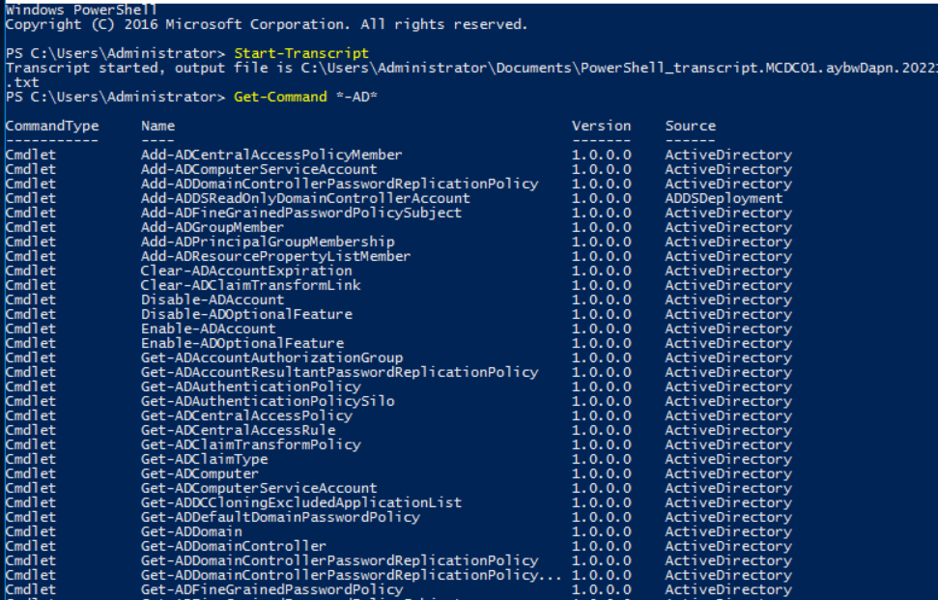
PowerShell Basics
Notes:
Since PowerShell script execution is enabled or not configured we can dive into some powershell basics that focuses on AD assistance.
On our domain controller we can first open up PowerShell by searching for it under our windows button and clicking on the first application called powershell. Once this open the first thing we will want to run is Start-Transcript. What this is going to do for us is record all of our powershell commands into a text file. Like the History command in linux.
Now that is turned on we are going to run a command that will provide us with relevant commands for AD
Get-Command *-AD*
As we can see we can perform a variety of commands to manipulate AD. Get domain information enable accounts / groups create new accounts or groups remove objects.
Now like linux if we have a bunch of output on our terminal we can use an alias to called CLS that will clear our terminal. If we wanted to look at all the aliases we can use in powershell we can run the command
Get-Alias (Show tabbing)
We will be using some of these alias to assist with our AD scripts.
We can also use our arrow keys to re issue commands that we previously run.
Tabbing our commands helps to because it will also show us all the other commands that can be run with our operator.
Getting into variables powershell can use variables to hold a value. If we type a $<variablename> = 10 we have just set a variable to equal 10 and if I type echo $variablename it will output the value we just set. We can also run variable + a value and it will add the values together.
Another command that will helpful to us is Get-Help <command Name> We can run like Get-Help Echo
Lets run Get-Help on Get-ADUser if we noticed we saw that powershell imported the AD module. Now if Active Directory was not installed on the member server this command would not run. We could also run Import-Module ActiveDirectory to simply import the module and then allow us to run AD commands
Looking at the output of Get-Help Get-ADUser we can see the name of the command then the proper syntax for how to utilize this command. If we look at the first one we can pull information by using the Filter parameter the next line shows us we can also use the Identity parameter, The last line shows us we can use the LDAPFilter parameter.
A recommended way to use this command is to utilize the Identity parameter
Get-ADUser –Identity “Administrator” We can see that the output shows us a decent amount of information but this is not all of it. We can see the DN if it is enabled the given name the actual name Obejct class object GUID SamAccountNAme SID Surname and UserPrinciaplName. This is just the Default information provided
If we run it with the filter parameter we can see the difference in syntax for the exact same output.
Get-ADUser –Filter {Name –eq ‘Administrator’}
We can also use the ObjectGUID to find the user and get the same output using the filter parameter Get-ADUser –Filter {ObjectGUID –eq ‘<objectguid>’}
The output we are seeing from these commands are nothing more than the attributes we could find in AD. If we enable advanced features and right click on the admin account we can view these attributes under the attribute editor.
Say we wanted to show an attribute that was not listed under our previous output well we can do that with the –Properties flag
Get-ADUser –Identiity ‘Administrator’ –Properties Description
This will provide us with the description attribute in our output
We can also set the attributes with powershell in AD how we do this is by issuing the
Set-ADUser “<Username>” –EmailAddress “<email>”
This will set our email attribute to our email address that we have.
To know what attribute flags to use we can use Get-Help Set-ADUser to list out the attributes that we can edit.
Now to view what we have just done we can run a history command to output all the commands that we have just run
Get-History

Slide 37
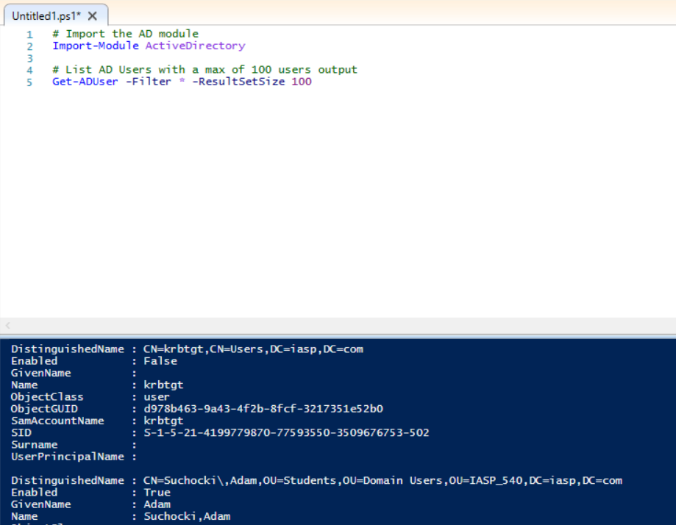
Listing AD Users with Powershell
Notes:
Since we have touched on some power Shell basics we are now going to dive into listing AD users.
Since we may want to repeat this process we are going to create a powershell script, to do this we will open up the PowerShell ISE. We are going to first write a comment using the # and comment in Import the active directory module
Next line of code will be the actual import-module ActiveDirectory
We are going to write another comment to list all AD Users with a max of 100 users
Get-ADUser –Filter * -ResultSetSize 100
After we run this we can now view the output of 100 users. This is not the best way to do this so we can pipe the output to another command by adding
| Select-Object Name
This output will be a lot easier to read. We can also add more attributes to select by using a coma as a separator
|Select-Object name, UserPrincipalName, Enabled
We can also choose different properties like lastlogon so we would add this property after our 100 users value
-Properties lastLogon
Get-ADUser –Filter * -ResultSetSize 100 –Properties lastLogon | Select-Object Name, Enabled, lastLogon
This is going to output the last logon time for the users, This output value is not human readable because it is the amount of seconds after 1997.
Now what if we have a scenario that we want to list all of the user accounts inside an AD OU
We would do some of the above but add in the searchbase flag
Get-ADUser –Filter * -SearchBase “iasp,com/users”
Now this is the hard way to get the correct search base but we can change directories to Active Directory
#cd AD:
#cd .\DC=iasp,DC-COM
#cd .\OU=IASP_540
Now we can see the Ous under the IASP_540 OU we are going to cd into the domain users OU as well
#cd .\OU=Domain users
Now we can see the full path to domain users. We are going to copy this path by highlighting out terminal and pasting it into our search base
Get-ADUser –Filter * -SearchBase “OU=Domain Users, OU=IASP_540,DC=iasp,DC=com”
The easy way to get the correct SearchBase is to go into AD and enable advanced features
Go to the OU you are looking for and right click to select properties
We can go to the attribute editor and scroll down to the DN.
We can copy this and paste this to our ISE.
Get-ADUser –Filter * -SearchBase “OU=Domain Users, OU=IASP_540,DC=iasp,DC=com” | Select-Object Name
Another scenario could you want to know all the users of a particular group well we could use AD but you cant copy the list of the group out so an easy way is to use PowerShell and issue the Get-ADGroupMember command
#Get-ADGroupMember ‘<group>’ | Select-Object Name, DistinguishedName
Now that we have our users listed out for the group we selected we can make life really easy by simply exporting the output to a csv file.
| export-Csv “C:\Documents\group_users.csv
We can also list out all of the accounts that are disabled / lockedout etc
#Search-ADAccount –AccountDisabled | Select-Object Name | export-Csv <File>

Slide 38
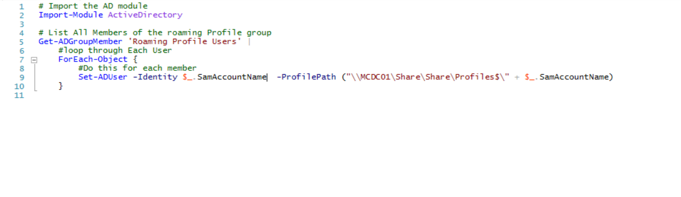
Roaming Profiles Using PowerShell
Notes:
Now we can use powershell to quickly set the value for our profile path for a particular user. In our ISE we can issue the command:
#Set-ADUser –Identity <User> -ProfilePath “\\MCDC01\Share\Share\Profiles$\suchockia”
Now this works but what if we have 1000 users we have to configure? We can make a script to perform this operation
We do what we did before and import the AD module
#import ad module
Import-Module ActiveDirectory
We are then going to list all members of our roaming Profile Group Then we will loop through each user and set the profile path. Now we are going to use Set-ADUser –Profile Path <Path> Then at the end we are going to using a $_. This will allow use to select an attribute of the current user the script is looping through. In this case we will use the SamAccountName attribute to append to the users profile path and create the user folder.
Ok now that is set we have to go back a bit and before our profilepath flag we need to add in the Identity flag so that the script can know what account attributes to look for while looping. We can copy and paste the $_.SamAccountName and add it after the –Identity flag
If we run this script we can confirm in AD that the users profile paths were updated.
If we save this script and call it roamingprofile.ps1 we can then say add this script to a schedule now and have it run everynight or we could just manually run it whenever.

Slide 39
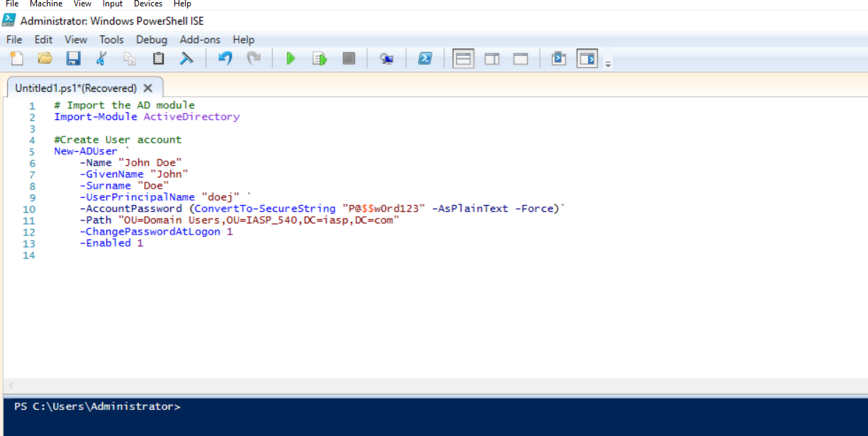
Creating User Accounts with PowerShell
Notes:
Using PowerShell we can create AD user Accounts. This makes life easier for us because we can automate this process for new users.
We are going to open our PowerShell ISE and begin writing our script. First thing is we are going to write our comment for importing the AD Module.
#Import module for AD
Import-module ActiveDirectory
We are now going to write our Create User Script I am going to be using a symbol called a grave accent to allow us to continue writing the script on another line.
#Create the AD User
New-ADUser ` (Grave Accent)
-Name “John Doe”
-GivenName “John”
-Surname “Doe”
-UserPrincipalName “doej” ` (Grave Accent)
Now we need to give the account a password and in order to do this we will add the –AccountPassword flag to our script. This needs to be converted to a secure string so to do that we will also need to add some more flags in ( )
-AccountPassword (ConvertTo-SecureString “P@$$w0rd123” –AsPlainText –Force) ` (Grave Accent)
We are going to have to specify the path in which we want this account to be provisioned under so the easiest way we could do this is to open AD and copy our Distinguished Name Path from our Domain Users OU
-Path “OU DN PATH”
Next I am going to set the –ChangePasswordAtLogon to 1
-ChangePasswordAtLogon 1
Finally I am going to enable the account
-Enabled 1
If we don’t specify the enabled flag by default the account will be disabled in AD
So lets check out the account we created in AD.
Now that we have our User creation syntax squared away lets grab some variables from our users.
I am going to write a Comment for #Grab variables from User
#Grab Variables from a user
Now we can create two variables first name and last name. This is going to prompt us to type in the first name and last name of our user.
$firstname = Read-Host –Prompt “Please enter the first name”
$lastname = Read-Host –Prompt “Please enter the first name”
Now we need to have the variable echo to our Create user Syntax So I am going to make some edits to the group of syntax inside our first set of grave accents
-Name “$firstname $lastname”
-GivenName “$firstname”
-Surname “$lastname”
-UserPrincipalName “$firstname $lastname”

Slide 40
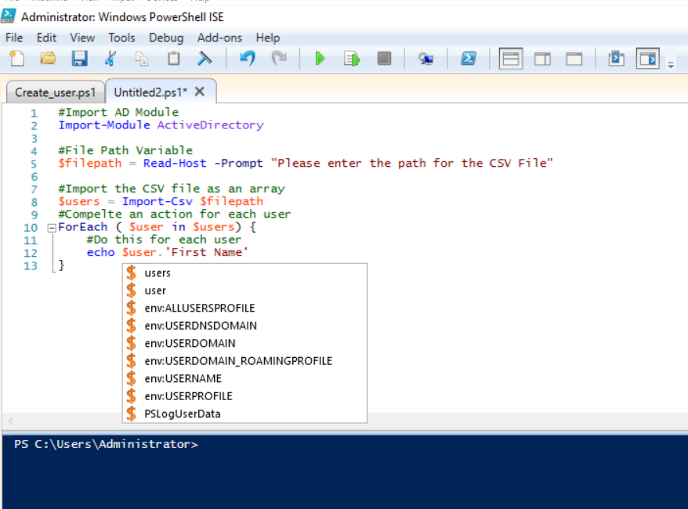
Creating User accounts from CSV
Notes:
Now that we know how to create a user account with PowerShell we are going to deal with a scenario where say we have a bunch of new users and we have their information listed out in a csv file. Well we can leverage that file to create all the accounts.
We are going to make a new powershell script that will pull the users from the csv file and create their accounts.
First we will import the module as usual.
Import-Module ActiveDirectory
Then we will create a variable called file path in which we will prompt the user to specify the path.
$filepath = Read-Host –Prompt “Please type the path of the CSV file”
Now that we have grabbed our file path variable we now need to import the that CSV file to our script. So to do that we are going to create another variable but this time call is users.
$users = Import-csv $filepath
We are calling the filepath variable that is going to be specified by the prompted user.
Next I want to show you how we can simply manipulate this csv data. We will need to make a for loop in order to have the script run through each excel line.
ForEach ($user in $users)
We can now start to manipulate the data like we can call only the first name of each user in the csv
Echo $user.’First Name’
If we run this we can now see that the data shows us the first name of each user. If we get rid of the first name extension and tab or get the drop down to show up we can see that there are other modifiers we can use to manipulate this data. (delete the period and add it back to get drop down.)
Alright now we can begin to write our create user script section we will write under the ForEach New-ADUser `(grave accent) Then begin to fill out our fields to create the users in AD.
-Name ($user.'First Name' + " " + $user.'Last Name') `
-GivenName $user.'First Name' `
-Surname $user.'Last Name' `
-UserPrincipalName ($user.'First Name' + " " + $user.'Last Name') `
-AccountPassword (ConvertTo-SecureString "P@$$w0rd123" -AsPlainText -Force) `
-Description $user.Description `
-EmailAddress $user.'Email Address' `
-Title $user.'Job Title' `
-officePhone $user.'Office Phone' `
-Path $user.'Organizational Unit' `
-ChangePasswordAtLogon 1 `
-Enabled $user.Enabled
Now we cant just use $user.enabled because this will return as a string. We need this to return as a Boolean in order for the system to enable the account. So we are actually going to add some syntax to this
-Enabled ([System.Convert]::ToBoolean($user.Enabled))
Now we can run this and check AD that all the accounts were created.
Looks Good!

Slide 41
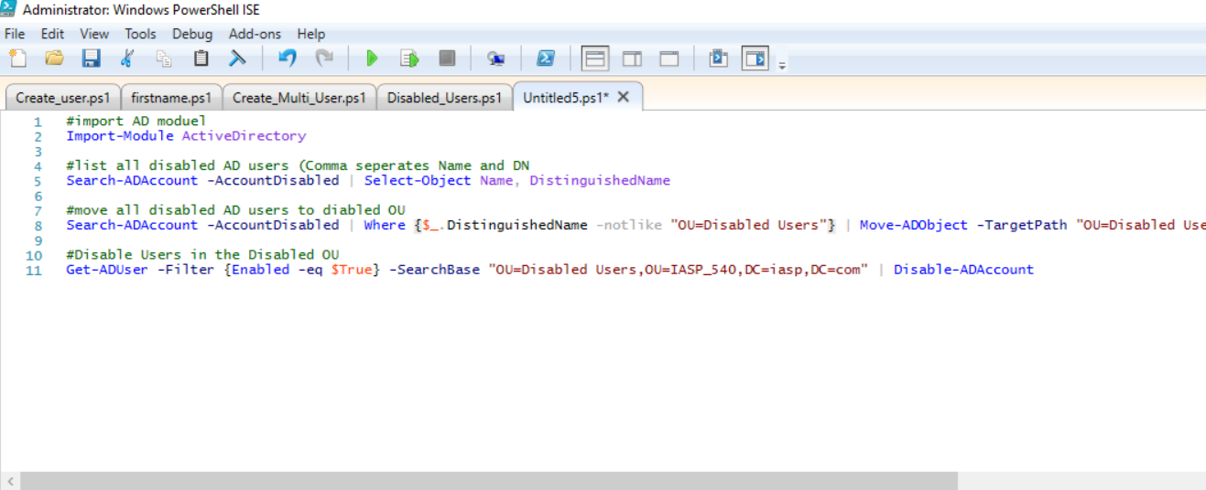
Move all Disabled User to OU
Notes:
Ok So now that we know how to make user accounts and utilize csvs to bulk create accounts lets write something that is basically like a clean up script for AD. We are going to make a script that will first list all of our disabled accounts in AD then move those accounts to an OU and then if there are any accounts in the disabled users OU that are not disabled, we will disable them.
So to start we are going import our module then list our disabled users in AD
Import-Module ActiveDirectory
Search-ADAccount –AccountDisabled | Select-Object Name, DistinguishedName
This is going to go through AD and list out all the accounts that are currently disabled. We can see from our CSV file that there are a few accounts that are disabled and not in the disabled users OU so lets write something to move them now.
Search-ADAccount –AccountDisabled | Move-ADObject –TargetPath “<DN>”
This is going to search for the disabled accounts and then move them to the Disabled Users OU. We can improve this though because this block of code is still going to crawl through the disabled users OU as well which is redundant. So we can add in a not like factor to this.
| Where {$_.DistinguishedName –notlike “OU-Disabled Users”}
Cool now that this is more reasonable we can move on to ensuring that the accounts in the disabled OU are actually disabled.
Get-ADUser –Filter {Enabled –eq $True} –SearchBase “<DN>” | Disable-ADAccount

Slide 42
BACKUP

Slide 43
05
AD Backup

Slide 44
Active Directory Backup

Slide 45
Active Directory Restore

Slide 46
Create AD Accounts with Duplicate names

